Slide 1
UNIT-3 Randomized Algorithms - Las Vegas-Randomized Quicksort, Monte Carlo Algorithms-Miller-Rabin Primality Test

Slide 2
Randomized Algorithms

Slide 3
Deterministic Algorithm
The output as well as the running time are functions only of the input.
Input
Output
Algorithm

Slide 4
Randomized Algorithm
The output or the running time are functions of the input and random bits chosen .
Random bits
Input
Output
Algorithm

Slide 5
“Randomized algorithm for a problem is usually simpler and more efficient than its deterministic counterpart.”

Slide 6
Two common types of algorithms
Las Vegas Algorithm
Always tells you the right answer
Takes varying amounts of time.
Example: Randomized Quick Sort
Monte Carlo Algorithm
Usually tells you the right answer (Output may be incorrect with some probability)
Running time is deterministic.
Example: Randomized algorithm for approximate median

Slide 7
Las Vegas vs Monte Carlo
A Las Vegas algorithm fails with some probability, but we can tell when it fails. In particular, we can run it again until it succeeds, which means that we can eventually succeed with probability 1 (but with a potentially unbounded running time).
Las Vegas algorithm runs for an unpredictable amount of time but always succeeds (we can convert such an algorithm back into one that runs in bounded time by declaring that it fails if it runs too long—a condition we can detect). QuickSort is an example of a Las Vegas algorithm.
A Monte Carlo algorithm fails with some probability, but we can’t tell when it fails. If the algorithm produces a yes/no answer and the failure probability is significantly less than 1/2, we can reduce the probability of failure by running it many times and taking a majority of the answers. The polynomial equality-testing algorithm in an example of a Monte Carlo algorithm.

Slide 8
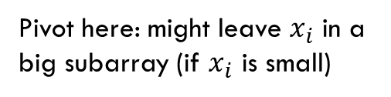
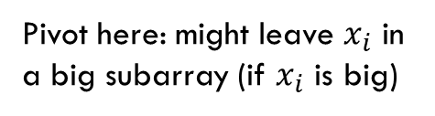
Example 1: Sorting
Deterministic Algorithms:
Heap sort
Merge Sort
Randomized Las Vegas algorithm:
Randomized Quick sort
Randomized Quick sort almost always outperforms heap sort and merge sort.
Probability[running time of quick sort exceeds twice its expected time] < $n^{−loglog n}$
For $n$= 1 million, this probability is ${10}^{−24}$

Slide 9
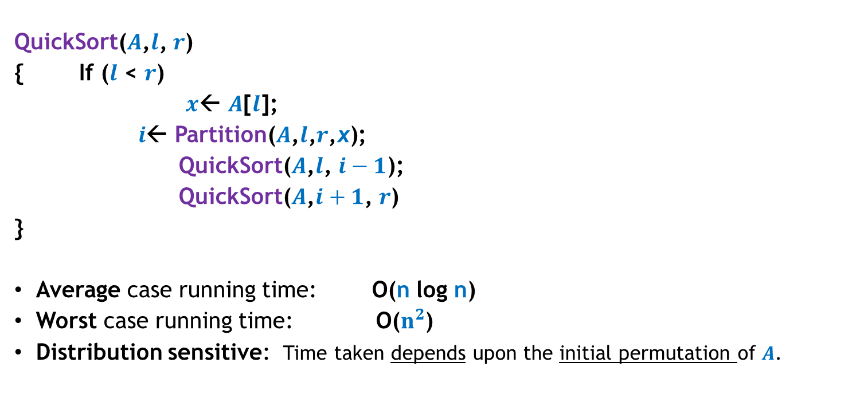
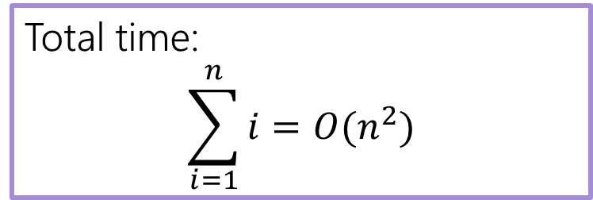
QuickSort($S$) When the input $S$is stored in an array $A$
QuickSort($A$,$l$, $r$)
{ If ($l$ < $r$)
$x$← $A$[$l$];
$i$← Partition($A$,$l$,$r$,x);
QuickSort($A$,$l$, $i−1$);
QuickSort($A$,$i+1$, $r$)
}
Average case running time: O(n log n)
Worst case running time: O($n^{2}$)
Distribution sensitive: Time taken depends upon the initial permutation of $A$.

Slide 10
Example
We are given array of n integers to sort:
40
20
10
80
60
50
7
30
100

Slide 11
Pick Pivot Element
There are a number of ways to pick the pivot element. In this example, we will use the first element in the array:
40
20
10
80
60
50
7
30
100

Slide 12
Partitioning Array
Given a pivot, partition the elements of the array such that the resulting array consists of:
One sub-array that contains elements >= pivot
Another sub-array that contains elements < pivot
The sub-arrays are stored in the original data array.
Partitioning loops through, swapping elements below/above pivot.

Slide 13
pivot_index = 0
40
20
10
80
60
50
7
30
100
[0] [1] [2] [3] [4] [5] [6] [7] [8]
too_big_index
too_small_index

Slide 14
While data[too_big_index] <= data[pivot]
++too_big_index
pivot_index = 0
40
20
10
80
60
50
7
30
100
[0] [1] [2] [3] [4] [5] [6] [7] [8]
too_big_index
too_small_index

Slide 15
While data[too_big_index] <= data[pivot]
++too_big_index
pivot_index = 0
40
20
10
80
60
50
7
30
100
[0] [1] [2] [3] [4] [5] [6] [7] [8]
too_big_index
too_small_index

Slide 16
While data[too_big_index] <= data[pivot]
++too_big_index
pivot_index = 0
40
20
10
80
60
50
7
30
100
[0] [1] [2] [3] [4] [5] [6] [7] [8]
too_big_index
too_small_index

Slide 17
While data[too_big_index] <= data[pivot]
++too_big_index
While data[too_small_index] > data[pivot]
--too_small_index
pivot_index = 0
40
20
10
80
60
50
7
30
100
[0] [1] [2] [3] [4] [5] [6] [7] [8]
too_big_index
too_small_index

Slide 18
While data[too_big_index] <= data[pivot]
++too_big_index
While data[too_small_index] > data[pivot]
--too_small_index
pivot_index = 0
40
20
10
80
60
50
7
30
100
[0] [1] [2] [3] [4] [5] [6] [7] [8]
too_big_index
too_small_index

Slide 19
While data[too_big_index] <= data[pivot]
++too_big_index
While data[too_small_index] > data[pivot]
--too_small_index
If too_big_index < too_small_index
swap data[too_big_index] and data[too_small_index]
pivot_index = 0
40
20
10
80
60
50
7
30
100
[0] [1] [2] [3] [4] [5] [6] [7] [8]
too_big_index
too_small_index

Slide 20
While data[too_big_index] <= data[pivot]
++too_big_index
While data[too_small_index] > data[pivot]
--too_small_index
If too_big_index < too_small_index
swap data[too_big_index] and data[too_small_index]
pivot_index = 0
40
20
10
30
60
50
7
80
100
[0] [1] [2] [3] [4] [5] [6] [7] [8]
too_big_index
too_small_index

Slide 21
While data[too_big_index] <= data[pivot]
++too_big_index
While data[too_small_index] > data[pivot]
--too_small_index
If too_big_index < too_small_index
swap data[too_big_index] and data[too_small_index]
While too_small_index > too_big_index, go to 1.
pivot_index = 0
40
20
10
30
60
50
7
80
100
[0] [1] [2] [3] [4] [5] [6] [7] [8]
too_big_index
too_small_index

Slide 22
While data[too_big_index] <= data[pivot]
++too_big_index
While data[too_small_index] > data[pivot]
--too_small_index
If too_big_index < too_small_index
swap data[too_big_index] and data[too_small_index]
While too_small_index > too_big_index, go to 1.
pivot_index = 0
40
20
10
30
60
50
7
80
100
[0] [1] [2] [3] [4] [5] [6] [7] [8]
too_big_index
too_small_index

Slide 23
While data[too_big_index] <= data[pivot]
++too_big_index
While data[too_small_index] > data[pivot]
--too_small_index
If too_big_index < too_small_index
swap data[too_big_index] and data[too_small_index]
While too_small_index > too_big_index, go to 1.
pivot_index = 0
40
20
10
30
60
50
7
80
100
[0] [1] [2] [3] [4] [5] [6] [7] [8]
too_big_index
too_small_index

Slide 24
While data[too_big_index] <= data[pivot]
++too_big_index
While data[too_small_index] > data[pivot]
--too_small_index
If too_big_index < too_small_index
swap data[too_big_index] and data[too_small_index]
While too_small_index > too_big_index, go to 1.
pivot_index = 0
40
20
10
30
60
50
7
80
100
[0] [1] [2] [3] [4] [5] [6] [7] [8]
too_big_index
too_small_index

Slide 25
While data[too_big_index] <= data[pivot]
++too_big_index
While data[too_small_index] > data[pivot]
--too_small_index
If too_big_index < too_small_index
swap data[too_big_index] and data[too_small_index]
While too_small_index > too_big_index, go to 1.
pivot_index = 0
40
20
10
30
60
50
7
80
100
[0] [1] [2] [3] [4] [5] [6] [7] [8]
too_big_index
too_small_index

Slide 26
While data[too_big_index] <= data[pivot]
++too_big_index
While data[too_small_index] > data[pivot]
--too_small_index
If too_big_index < too_small_index
swap data[too_big_index] and data[too_small_index]
While too_small_index > too_big_index, go to 1.
pivot_index = 0
40
20
10
30
60
50
7
80
100
[0] [1] [2] [3] [4] [5] [6] [7] [8]
too_big_index
too_small_index

Slide 27
While data[too_big_index] <= data[pivot]
++too_big_index
While data[too_small_index] > data[pivot]
--too_small_index
If too_big_index < too_small_index
swap data[too_big_index] and data[too_small_index]
While too_small_index > too_big_index, go to 1.
pivot_index = 0
40
20
10
30
7
50
60
80
100
[0] [1] [2] [3] [4] [5] [6] [7] [8]
too_big_index
too_small_index

Slide 28
While data[too_big_index] <= data[pivot]
++too_big_index
While data[too_small_index] > data[pivot]
--too_small_index
If too_big_index < too_small_index
swap data[too_big_index] and data[too_small_index]
While too_small_index > too_big_index, go to 1.
pivot_index = 0
40
20
10
30
7
50
60
80
100
[0] [1] [2] [3] [4] [5] [6] [7] [8]
too_big_index
too_small_index

Slide 29
While data[too_big_index] <= data[pivot]
++too_big_index
While data[too_small_index] > data[pivot]
--too_small_index
If too_big_index < too_small_index
swap data[too_big_index] and data[too_small_index]
While too_small_index > too_big_index, go to 1.
pivot_index = 0
40
20
10
30
7
50
60
80
100
[0] [1] [2] [3] [4] [5] [6] [7] [8]
too_big_index
too_small_index

Slide 30
While data[too_big_index] <= data[pivot]
++too_big_index
While data[too_small_index] > data[pivot]
--too_small_index
If too_big_index < too_small_index
swap data[too_big_index] and data[too_small_index]
While too_small_index > too_big_index, go to 1.
pivot_index = 0
40
20
10
30
7
50
60
80
100
[0] [1] [2] [3] [4] [5] [6] [7] [8]
too_big_index
too_small_index

Slide 31
While data[too_big_index] <= data[pivot]
++too_big_index
While data[too_small_index] > data[pivot]
--too_small_index
If too_big_index < too_small_index
swap data[too_big_index] and data[too_small_index]
While too_small_index > too_big_index, go to 1.
pivot_index = 0
40
20
10
30
7
50
60
80
100
[0] [1] [2] [3] [4] [5] [6] [7] [8]
too_big_index
too_small_index

Slide 32
While data[too_big_index] <= data[pivot]
++too_big_index
While data[too_small_index] > data[pivot]
--too_small_index
If too_big_index < too_small_index
swap data[too_big_index] and data[too_small_index]
While too_small_index > too_big_index, go to 1.
pivot_index = 0
40
20
10
30
7
50
60
80
100
[0] [1] [2] [3] [4] [5] [6] [7] [8]
too_big_index
too_small_index

Slide 33
While data[too_big_index] <= data[pivot]
++too_big_index
While data[too_small_index] > data[pivot]
--too_small_index
If too_big_index < too_small_index
swap data[too_big_index] and data[too_small_index]
While too_small_index > too_big_index, go to 1.
pivot_index = 0
40
20
10
30
7
50
60
80
100
[0] [1] [2] [3] [4] [5] [6] [7] [8]
too_big_index
too_small_index

Slide 34
While data[too_big_index] <= data[pivot]
++too_big_index
While data[too_small_index] > data[pivot]
--too_small_index
If too_big_index < too_small_index
swap data[too_big_index] and data[too_small_index]
While too_small_index > too_big_index, go to 1.
pivot_index = 0
40
20
10
30
7
50
60
80
100
[0] [1] [2] [3] [4] [5] [6] [7] [8]
too_big_index
too_small_index

Slide 35
While data[too_big_index] <= data[pivot]
++too_big_index
While data[too_small_index] > data[pivot]
--too_small_index
If too_big_index < too_small_index
swap data[too_big_index] and data[too_small_index]
While too_small_index > too_big_index, go to 1.
pivot_index = 0
40
20
10
30
7
50
60
80
100
[0] [1] [2] [3] [4] [5] [6] [7] [8]
too_big_index
too_small_index

Slide 36
While data[too_big_index] <= data[pivot]
++too_big_index
While data[too_small_index] > data[pivot]
--too_small_index
If too_big_index < too_small_index
swap data[too_big_index] and data[too_small_index]
While too_small_index > too_big_index, go to 1.
Swap data[too_small_index] and data[pivot_index]
pivot_index = 0
40
20
10
30
7
50
60
80
100
[0] [1] [2] [3] [4] [5] [6] [7] [8]
too_big_index
too_small_index

Slide 37
While data[too_big_index] <= data[pivot]
++too_big_index
While data[too_small_index] > data[pivot]
--too_small_index
If too_big_index < too_small_index
swap data[too_big_index] and data[too_small_index]
While too_small_index > too_big_index, go to 1.
Swap data[too_small_index] and data[pivot_index]
7
20
10
30
40
50
60
80
100
pivot_index = 4
[0] [1] [2] [3] [4] [5] [6] [7] [8]
too_big_index
too_small_index

Slide 38
Partition Result
7
20
10
30
40
50
60
80
100
[0] [1] [2] [3] [4] [5] [6] [7] [8]
<= data[pivot]
> data[pivot]

Slide 39
Recursion: Quicksort Sub-arrays
7
20
10
30
40
50
60
80
100
[0] [1] [2] [3] [4] [5] [6] [7] [8]
<= data[pivot]
> data[pivot]

Slide 40
Quicksort: Worst Case
Assume first element is chosen as pivot.
Assume we get array that is already in order:
pivot_index = 0
2
4
10
12
13
50
57
63
100
[0] [1] [2] [3] [4] [5] [6] [7] [8]
too_big_index
too_small_index

Slide 41
While data[too_big_index] <= data[pivot]
++too_big_index
While data[too_small_index] > data[pivot]
--too_small_index
If too_big_index < too_small_index
swap data[too_big_index] and data[too_small_index]
While too_small_index > too_big_index, go to 1.
Swap data[too_small_index] and data[pivot_index]
pivot_index = 0
2
4
10
12
13
50
57
63
100
[0] [1] [2] [3] [4] [5] [6] [7] [8]
too_big_index
too_small_index

Slide 42
While data[too_big_index] <= data[pivot]
++too_big_index
While data[too_small_index] > data[pivot]
--too_small_index
If too_big_index < too_small_index
swap data[too_big_index] and data[too_small_index]
While too_small_index > too_big_index, go to 1.
Swap data[too_small_index] and data[pivot_index]
pivot_index = 0
2
4
10
12
13
50
57
63
100
[0] [1] [2] [3] [4] [5] [6] [7] [8]
too_big_index
too_small_index

Slide 43
While data[too_big_index] <= data[pivot]
++too_big_index
While data[too_small_index] > data[pivot]
--too_small_index
If too_big_index < too_small_index
swap data[too_big_index] and data[too_small_index]
While too_small_index > too_big_index, go to 1.
Swap data[too_small_index] and data[pivot_index]
pivot_index = 0
2
4
10
12
13
50
57
63
100
[0] [1] [2] [3] [4] [5] [6] [7] [8]
too_big_index
too_small_index

Slide 44
While data[too_big_index] <= data[pivot]
++too_big_index
While data[too_small_index] > data[pivot]
--too_small_index
If too_big_index < too_small_index
swap data[too_big_index] and data[too_small_index]
While too_small_index > too_big_index, go to 1.
Swap data[too_small_index] and data[pivot_index]
pivot_index = 0
2
4
10
12
13
50
57
63
100
[0] [1] [2] [3] [4] [5] [6] [7] [8]
too_big_index
too_small_index

Slide 45
While data[too_big_index] <= data[pivot]
++too_big_index
While data[too_small_index] > data[pivot]
--too_small_index
If too_big_index < too_small_index
swap data[too_big_index] and data[too_small_index]
While too_small_index > too_big_index, go to 1.
Swap data[too_small_index] and data[pivot_index]
pivot_index = 0
2
4
10
12
13
50
57
63
100
[0] [1] [2] [3] [4] [5] [6] [7] [8]
too_big_index
too_small_index

Slide 46
While data[too_big_index] <= data[pivot]
++too_big_index
While data[too_small_index] > data[pivot]
--too_small_index
If too_big_index < too_small_index
swap data[too_big_index] and data[too_small_index]
While too_small_index > too_big_index, go to 1.
Swap data[too_small_index] and data[pivot_index]
pivot_index = 0
2
4
10
12
13
50
57
63
100
[0] [1] [2] [3] [4] [5] [6] [7] [8]
too_big_index
too_small_index

Slide 47
While data[too_big_index] <= data[pivot]
++too_big_index
While data[too_small_index] > data[pivot]
--too_small_index
If too_big_index < too_small_index
swap data[too_big_index] and data[too_small_index]
While too_small_index > too_big_index, go to 1.
Swap data[too_small_index] and data[pivot_index]
pivot_index = 0
2
4
10
12
13
50
57
63
100
[0] [1] [2] [3] [4] [5] [6] [7] [8]
<= data[pivot]
> data[pivot]

Slide 48
Quicksort Analysis
Assume that keys are random, uniformly distributed.
Best case running time: O(n log₂n)
Worst case running time?
Recursion:
Partition splits array in two sub-arrays:
one sub-array of size 0
the other sub-array of size n-1
Quicksort each sub-array
Depth of recursion tree?

Slide 49
Quicksort Analysis
Assume that keys are random, uniformly distributed.
Best case running time: O(n log₂n)
Worst case running time?
Recursion:
Partition splits array in two sub-arrays:
one sub-array of size 0
the other sub-array of size n-1
Quicksort each sub-array
Depth of recursion tree? O(n)

Slide 50
Quicksort Analysis
Assume that keys are random, uniformly distributed.
Best case running time: O(n log₂n)
Worst case running time?
Recursion:
Partition splits array in two sub-arrays:
one sub-array of size 0
the other sub-array of size n-1
Quicksort each sub-array
Depth of recursion tree? O(n)
Number of accesses per partition?

Slide 51
Quicksort Analysis
Assume that keys are random, uniformly distributed.
Best case running time: O(n log₂n)
Worst case running time?
Recursion:
Partition splits array in two sub-arrays:
one sub-array of size 0
the other sub-array of size n-1
Quicksort each sub-array
Depth of recursion tree? O(n)
Number of accesses per partition? O(n)

Slide 52
Quicksort Analysis
Assume that keys are random, uniformly distributed.
Best case running time: O(n log₂n)
Worst case running time: O(n²)!!!

Slide 53
Randomized Quick Sort algorithm
Assuming all elements are distinct
We pick a random element x as the pivot and partition the input set S into two sets L and R such:
L = numbers less than x
R = numbers greater than x
Recursively sort L and R.
Return LxR

Slide 54
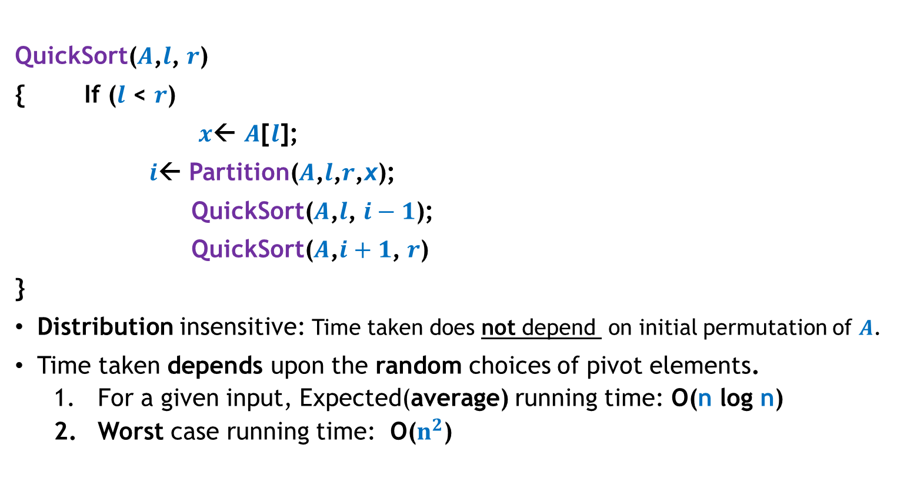

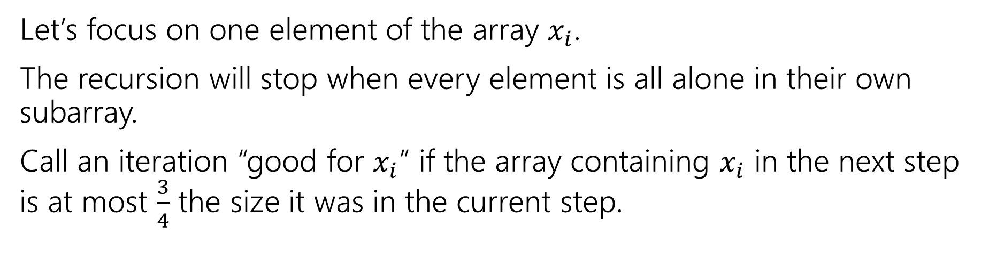
Randomized QuickSort($S$) When the input $S$is stored in an array $A$
QuickSort($A$,$l$, $r$)
{ If ($l$ < $r$)
$x$← $A$[$l$];
$i$← Partition($A$,$l$,$r$,x);
QuickSort($A$,$l$, $i−1$);
QuickSort($A$,$i+1$, $r$)
}
Distribution insensitive: Time taken does not depend on initial permutation of $A$.
Time taken depends upon the random choices of pivot elements.
For a given input, Expected(average) running time: O(n log n)
Worst case running time: O($n^{2}$)
an element selected randomly uniformly from $A$[$l$..$r$];

Slide 55


Example: Primality Testing
Problem definition: Given an n bit integer, determine if it is prime.
Applications:
RSA-cryptosystem,
Algebraic algorithms
Best deterministic algorithm : [Agrawal, Kayal and Saxena, 2002]
O($n^{6}$ ) time complexity.
Randomized Monte Carlo algorithm: [Rabin, 1980]
O(k $n^{2}$ ) time complexity.
Error probability: $2^{−k}$ for any $k$ that we desire
For $n$= 50, this probability is ${10}^{−15}$

Slide 56
Uncertainty Associated with randomized Algorithms Is it really a serious issue ?

Slide 57
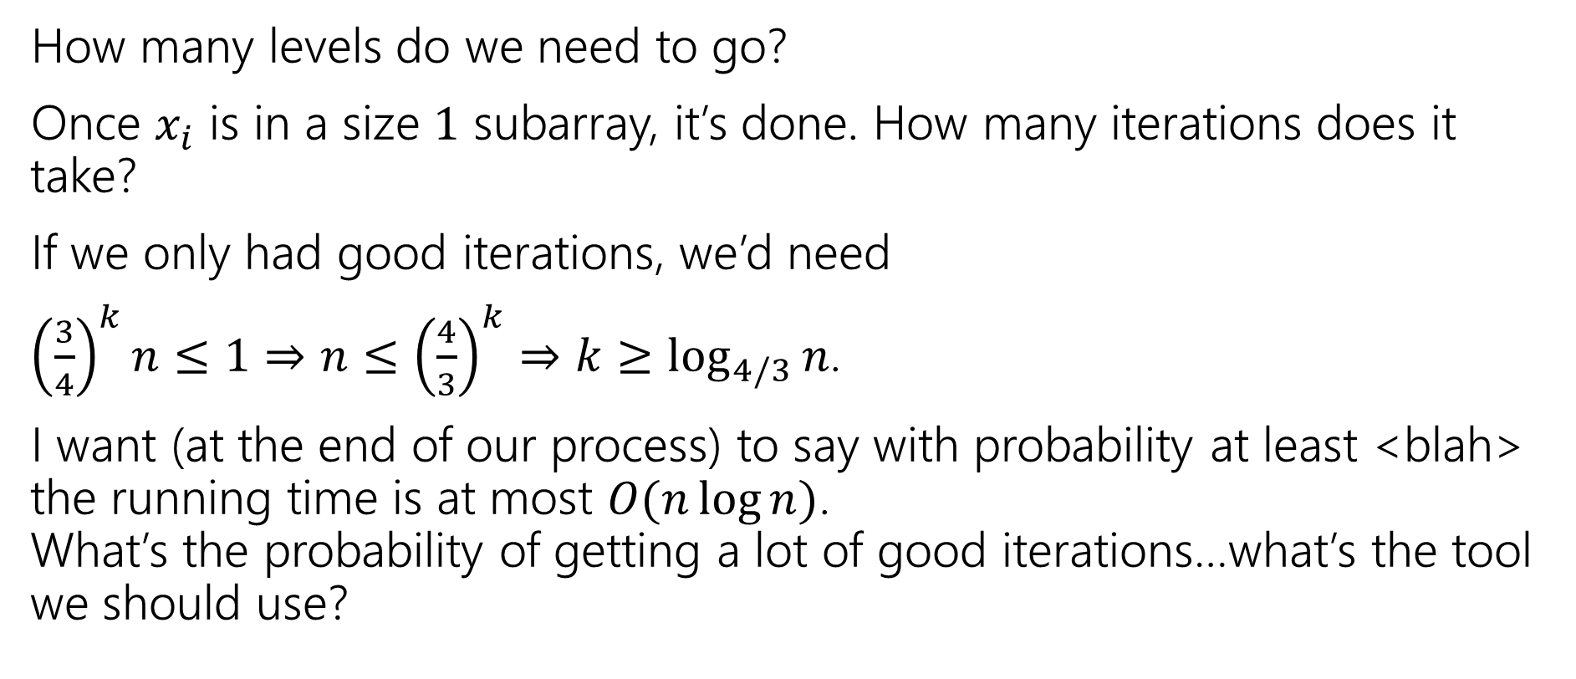
A real Fact [A study by Microsoft in 2008]
If we run a CPU for 5 days, probability of its failure during this interval is 1/330.
Probability[a CPU fails in one second] > ${10}^{−9}$
The reference of the study is:
E.B. Nightingale, J.P. Douceur, Vince Orgovan. Cycles, Cells, and Platters: An Empirical Analysis of Hardware Failures on a Million PCs. In Proceedings of EuroSys 2011. (awarded “Best Paper”). A copy is available on the course webpage as well.
Compare this probability with the failure (or exceeding the running time) probability of various randomized algorithms mentioned earlier.

Slide 58
The Quick Sort Problem
To sort a given set of numbers
In traditional quick sort algorithm, we pick a particular index element as pivot for splitting.
Worst Case: O(n² )
Average Case: O(n log n)
A good pivot can be selected using median finding algorithm but the total complexity will again be O(n² ).
So, what if we pick a random element uniformly as pivot and do the partition. We will show that this takes expected O(n log n) time.

Slide 59
Rabin-Miller Primality Test
Miller Rabin is a fast approach to test primality of the large numbers.
This algorithm is called a Rabin-miller primality test and this algorithm decides whether number is prime which is same to other tests including Fermat primality Test and Solovay-Strassen primality test.
This algorithm is most useful known primality testing algorithm and can be used in different software libraries that based on RSA encryption and best instance is OpenSSL.
Miller Rabin is associatively simple extension of Fermats little Theorem that enable us to test for primality with a much larger probability than Fermats little theorem.

Slide 60
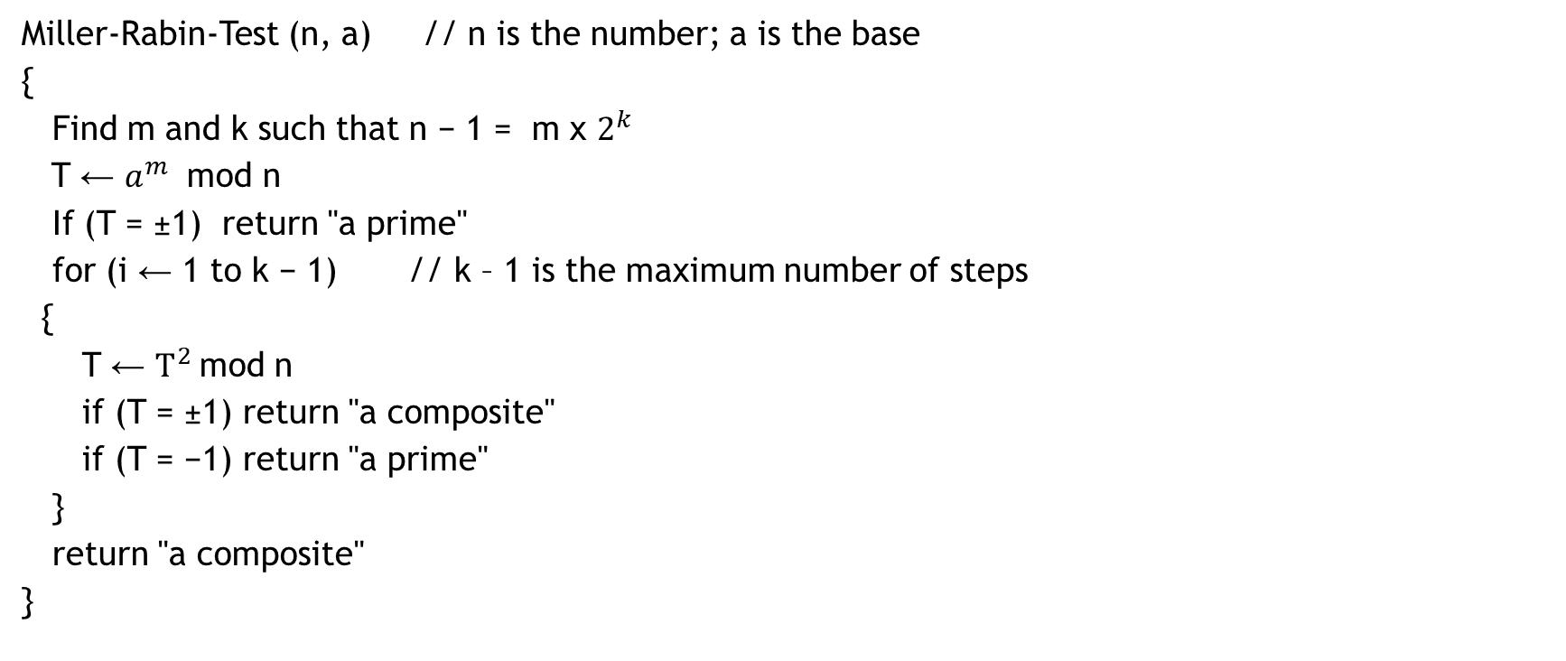
Miller-Rabin Algorithm
Miller-Rabin-Test (n, a) // n is the number; a is the base
{
Find m and k such that n − 1 = m x $2^{k}$
T ← $a^{m}$ mod n
If (T = ±1) return "a prime"
for (i ← 1 to k − 1) // k – 1 is the maximum number of steps
{
T ← $T^{2}$mod n
if (T = ±1) return "a composite"
if (T = −1) return "a prime"
}
return "a composite"
}

Slide 61
Modular Exponentiation

Slide 62
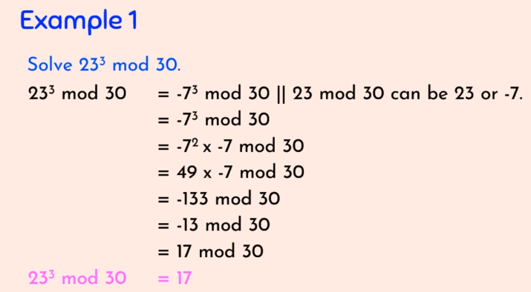

Modular Exponentiation
$a^{b}$ mod m or $a^{b}$ (mod m)
Eg: ${23}^{3}$ (mod 30)

Slide 63
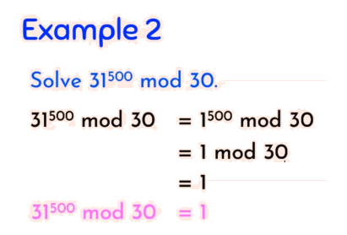

Slide 64
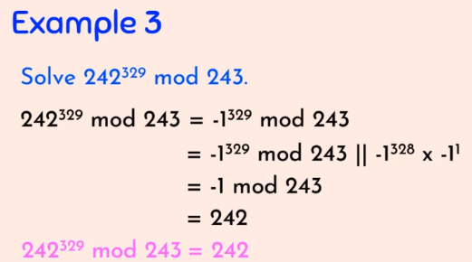

Slide 65
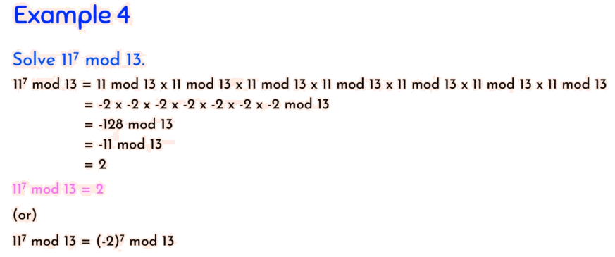

Slide 66
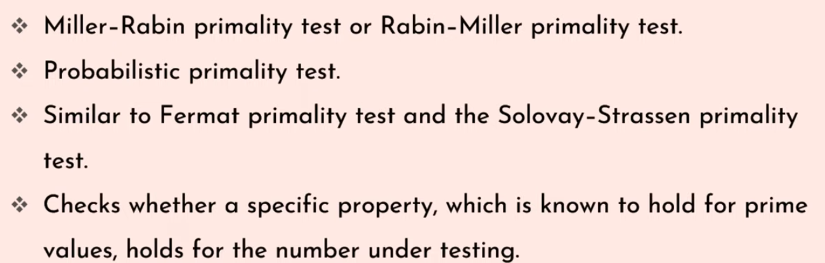
Testing for Primality (Miller-Rabin Test)

Slide 67
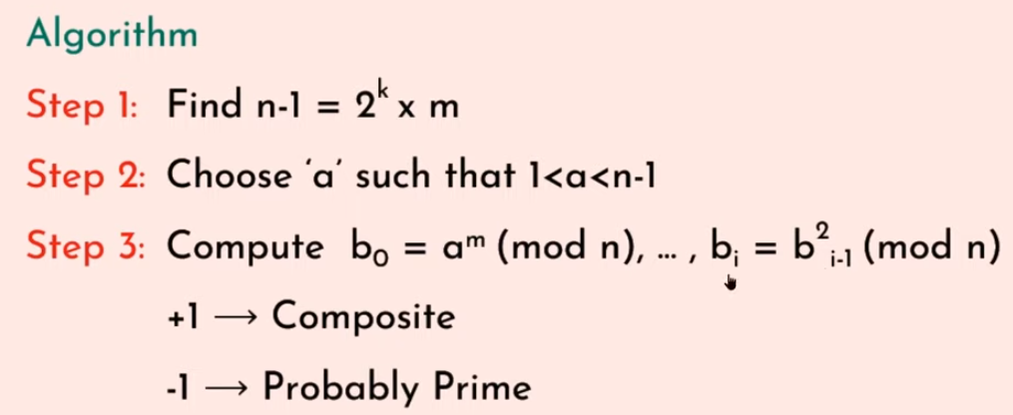
Testing for Primality (Miller-Rabin Test)

Slide 68
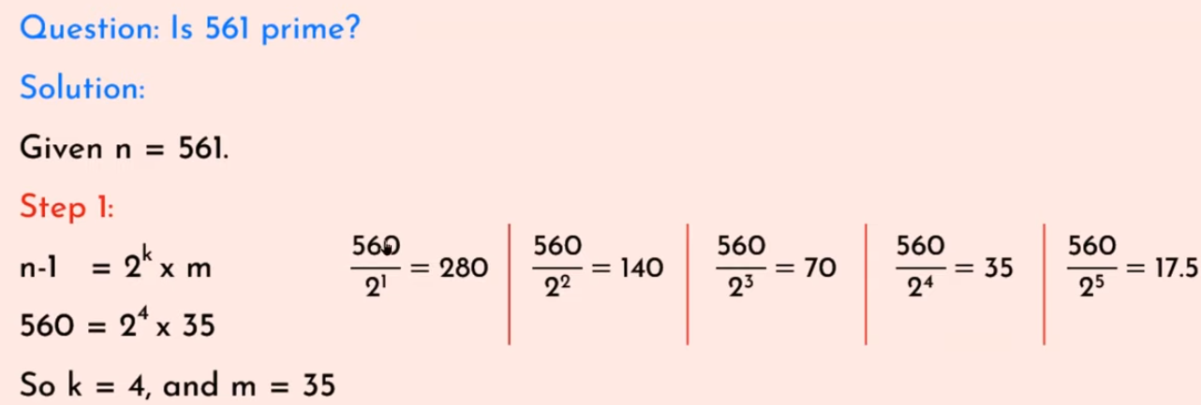
Testing for Primality (Miller-Rabin Test)

Slide 69
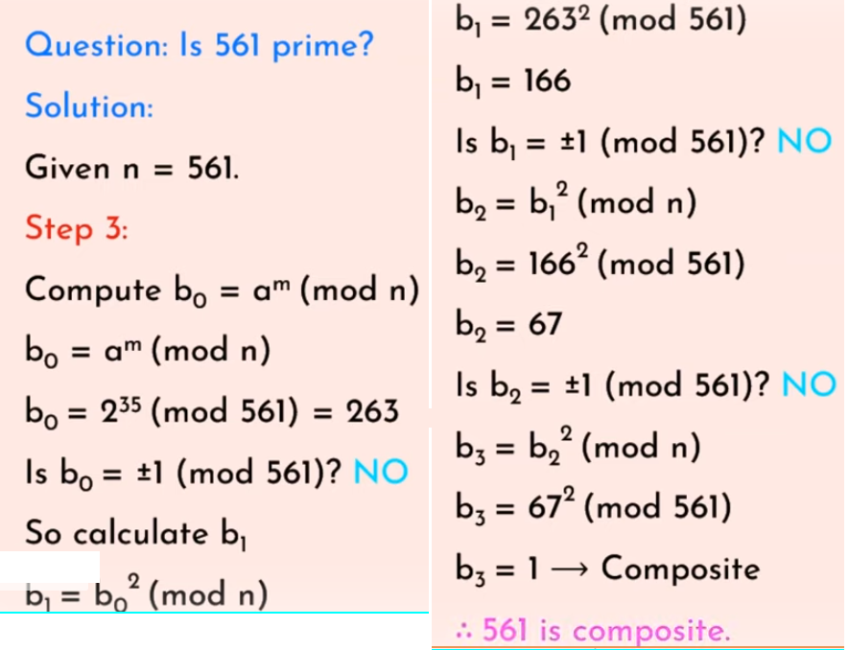
Testing for Primality (Miller-Rabin Test) – Example1

Slide 70
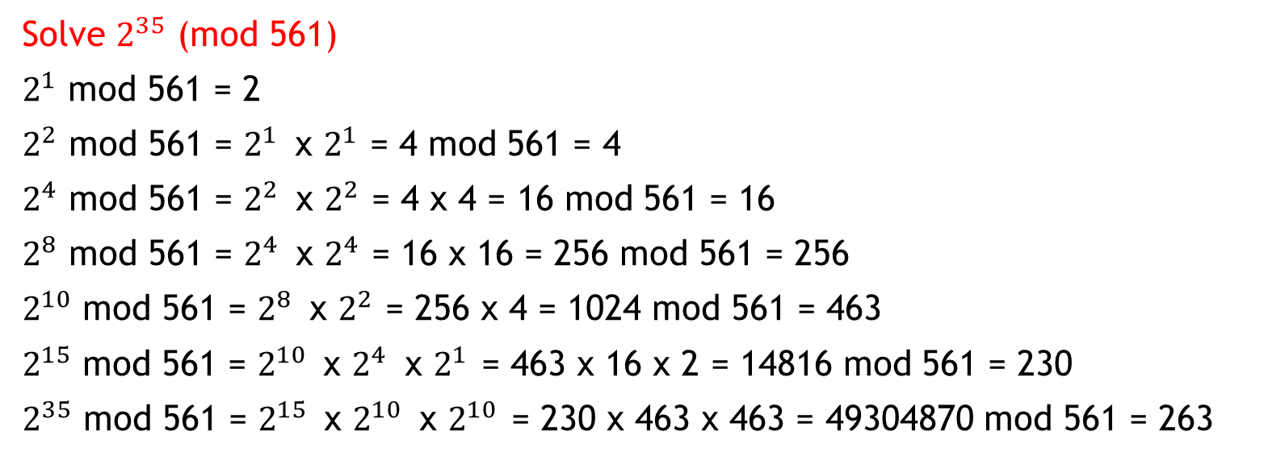
Modular Exponentiation
Solve $2^{35}$ (mod 561)
$2^{1}$ mod 561 = 2
$2^{2}$ mod 561 = $2^{1 }$ x $2^{1}$ = 4 mod 561 = 4
$2^{4}$ mod 561 = $2^{2 }$ x $2^{2}$ = 4 x 4 = 16 mod 561 = 16
$2^{8}$ mod 561 = $2^{4 }$ x $2^{4}$ = 16 x 16 = 256 mod 561 = 256
$2^{10}$ mod 561 = $2^{8 }$ x $2^{2}$ = 256 x 4 = 1024 mod 561 = 463
$2^{15}$ mod 561 = $2^{10 }$ x $2^{4 }$ x $2^{1 }$= 463 x 16 x 2 = 14816 mod 561 = 230
$2^{35}$ mod 561 = $2^{15 }$ x $2^{10 }$ x $2^{10 }$= 230 x 463 x 463 = 49304870 mod 561 = 263

Slide 71
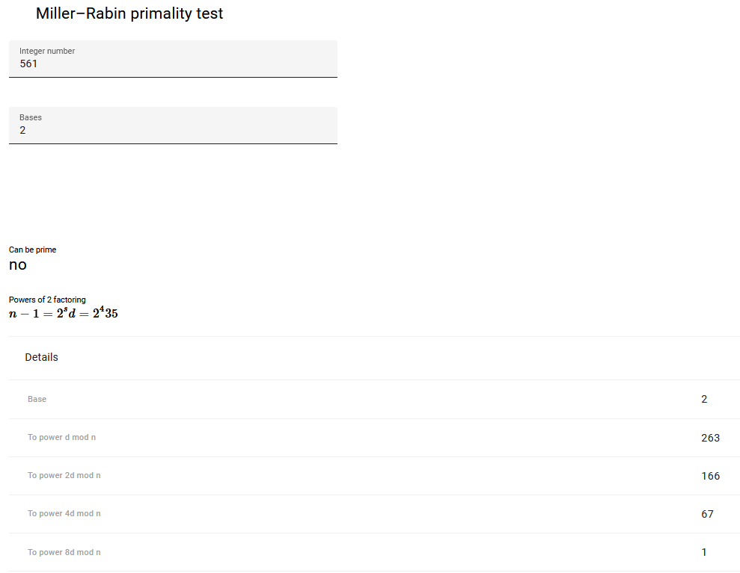
(Miller-Rabin Test) – Example1

Slide 72
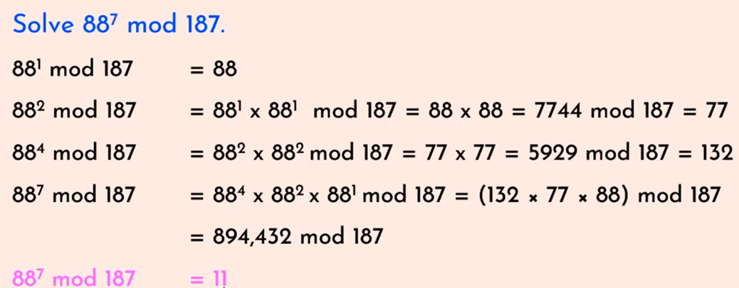
Modular Exponentiation

Slide 73
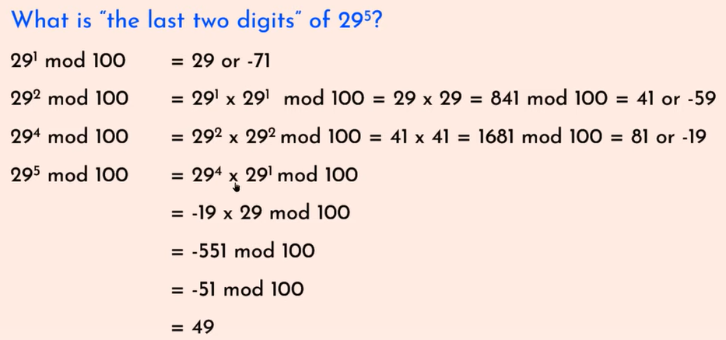
Modular Exponentiation

Slide 74
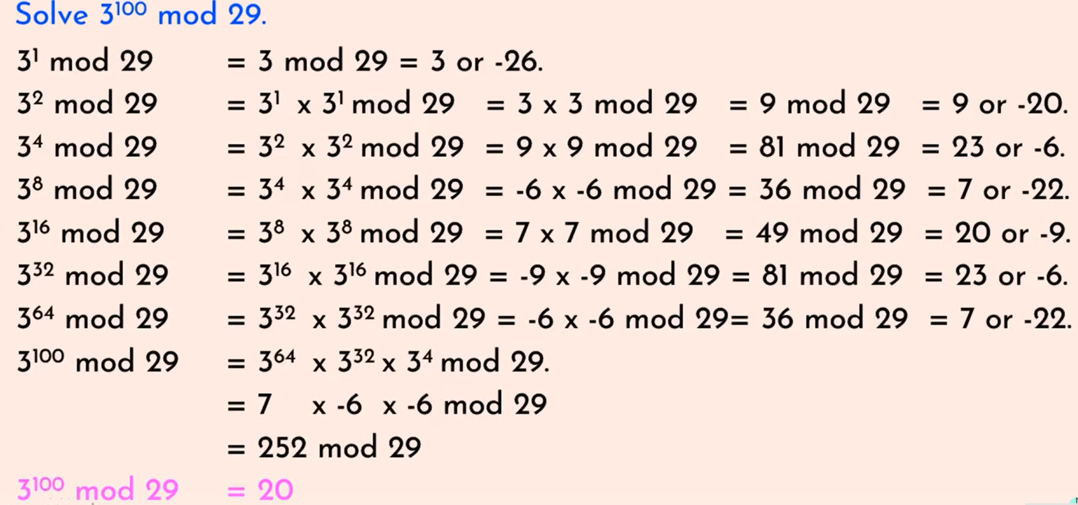
Modular Exponentiation

Slide 75
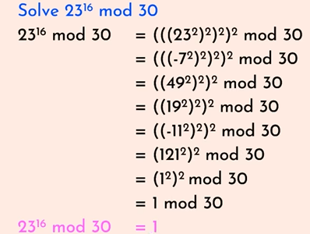
Modular Exponentiation

Slide 76

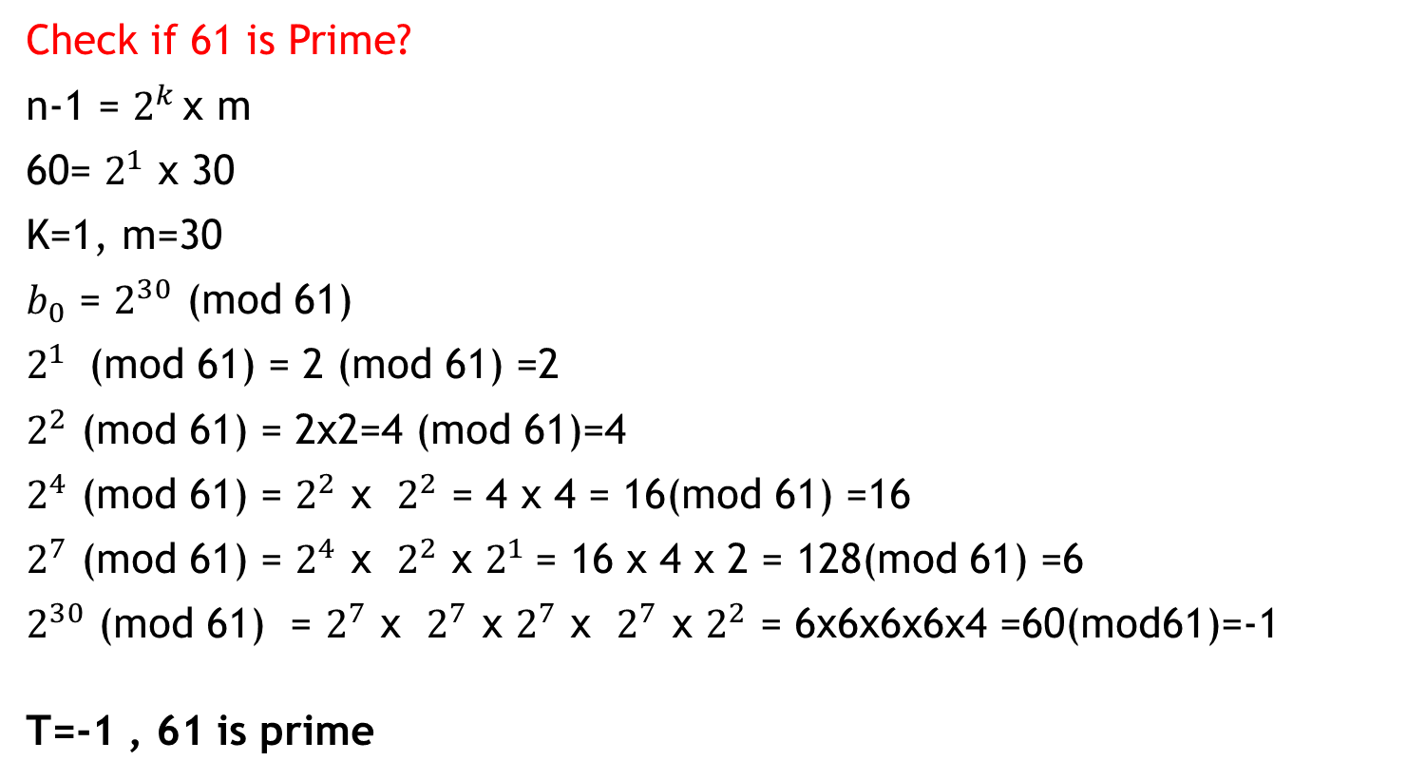
Testing for Primality (Miller-Rabin Test)
Check if 61 is Prime?
n-1 = $2^{k }$x m
60= $2^{1}$ x 30
K=1, m=30
$b_{0}$ = $2^{30}$ (mod 61)
$2^{1}$ (mod 61) = 2 (mod 61) =2
$2^{2}$ (mod 61) = 2x2=4 (mod 61)=4
$2^{4}$ (mod 61) = $2^{2}$ x $2^{2}$ = 4 x 4 = 16(mod 61) =16
$2^{7}$ (mod 61) = $2^{4}$ x $2^{2}$ x $2^{1}$= 16 x 4 x 2 = 128(mod 61) =6
$2^{30}$ (mod 61) = $2^{7}$ x $2^{7}$ x $2^{7}$ x $2^{7}$ x $2^{2}$ = 6x6x6x6x4 =60(mod61)=-1
T=-1 , 61 is prime

Slide 77
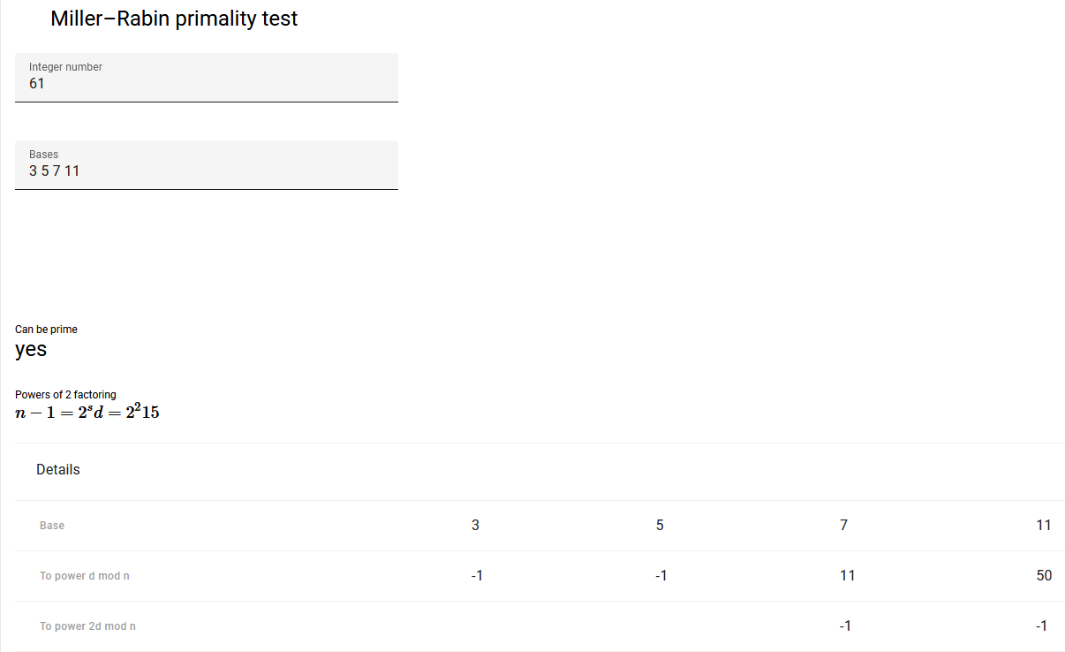
Check if 61 is Prime?

Slide 78
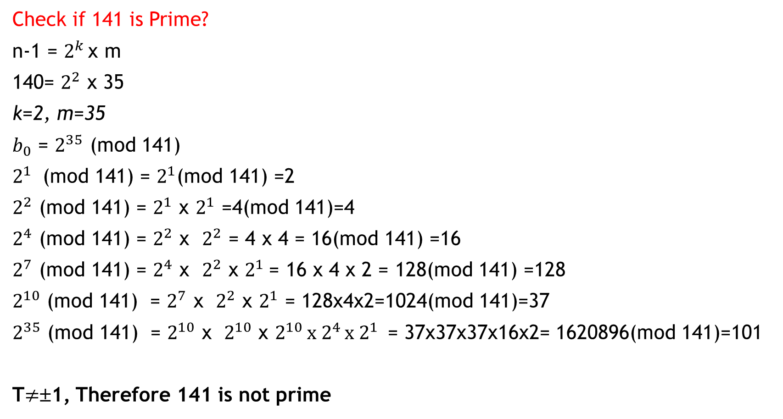
Modular Exponentiation
Check if 141 is Prime?
n-1 = $2^{k }$x m
140= $2^{2}$ x 35
k=2, m=35
$b_{0}$ = $2^{35}$ (mod 141)
$2^{1}$ (mod 141) = $2^{1}$(mod 141) =2
$2^{2}$ (mod 141) = $2^{1}$ x $2^{1}$ =4(mod 141)=4
$2^{4}$ (mod 141) = $2^{2}$ x $2^{2}$ = 4 x 4 = 16(mod 141) =16
$2^{7}$ (mod 141) = $2^{4}$ x $2^{2}$ x $2^{1}$= 16 x 4 x 2 = 128(mod 141) =128
$2^{10}$ (mod 141) = $2^{7}$ x $2^{2}$ x $2^{1}$ = 128x4x2=1024(mod 141)=37
$2^{35}$ (mod 141) = $2^{10}$ x $2^{10}$ x $2^{10 }x 2^{4 }x 2^{1 }$ = 37x37x37x16x2= 1620896(mod 141)=101
T$≠$±1, Therefore 141 is not prime

Slide 79
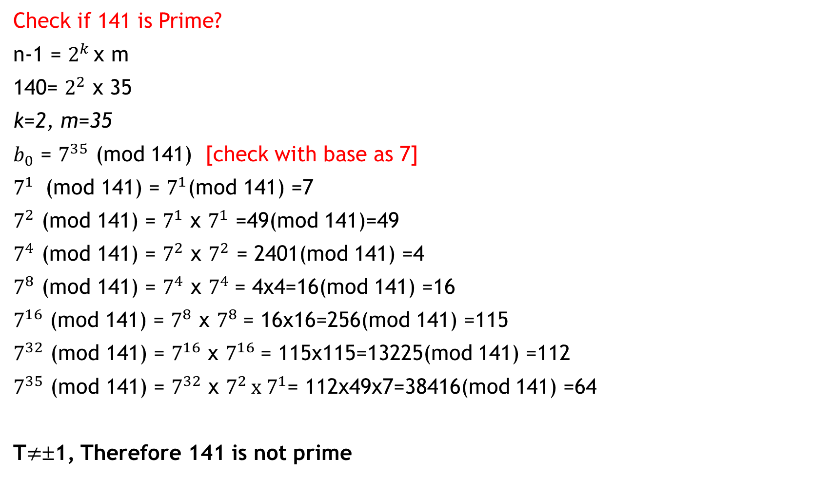
Modular Exponentiation
Check if 141 is Prime?
n-1 = $2^{k }$x m
140= $2^{2}$ x 35
k=2, m=35
$b_{0}$ = $7^{35}$ (mod 141) [check with base as 7]
$7^{1}$ (mod 141) = $7^{1}$(mod 141) =7
$7^{2}$ (mod 141) = $7^{1}$ x $7^{1}$ =49(mod 141)=49
$7^{4}$ (mod 141) = $7^{2}$ x $7^{2}$ = 2401(mod 141) =4
$7^{8}$ (mod 141) = $7^{4}$ x $7^{4}$= 4x4=16(mod 141) =16
$7^{16}$ (mod 141) = $7^{8}$ x $7^{8}$= 16x16=256(mod 141) =115
$7^{32}$ (mod 141) = $7^{16}$ x $7^{16}$= 115x115=13225(mod 141) =112
$7^{35}$ (mod 141) = $7^{32}$ x $7^{2 }x 7^{1}$= 112x49x7=38416(mod 141) =64
T$≠$±1, Therefore 141 is not prime

Slide 80
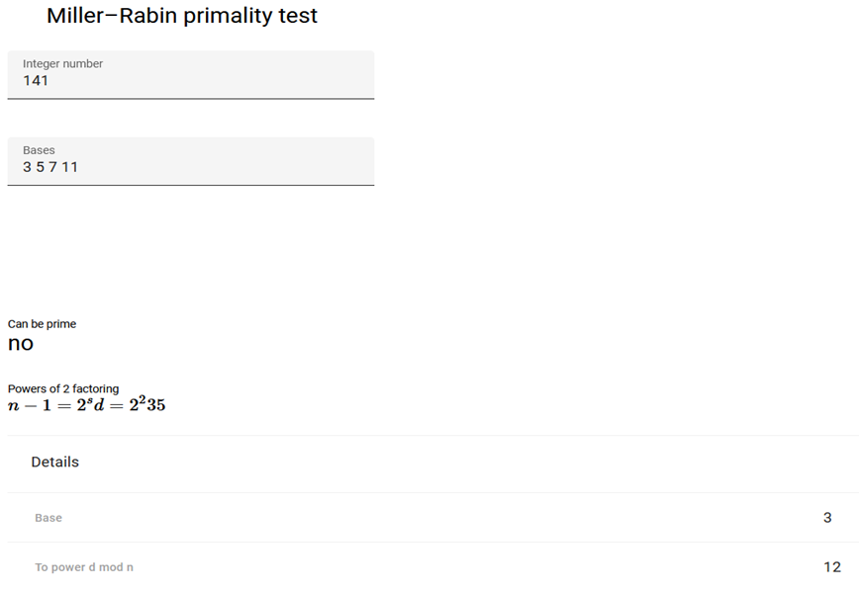
Check if 141 is Prime?

Slide 81
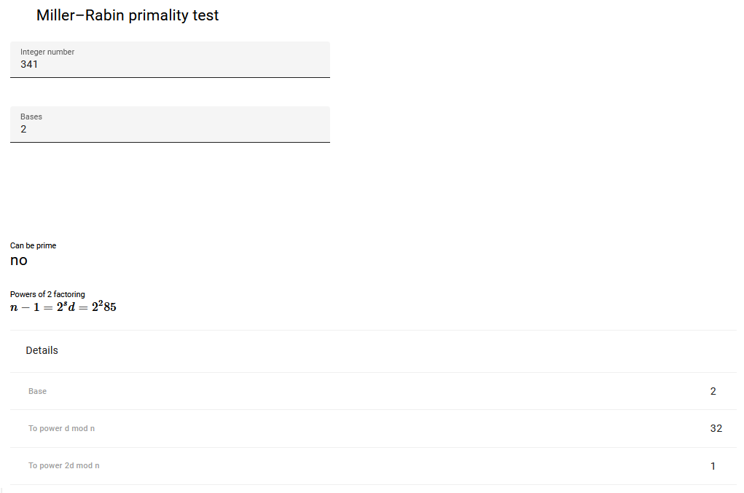
Check if 341 is Prime?
341 is a Composite Number

Slide 82
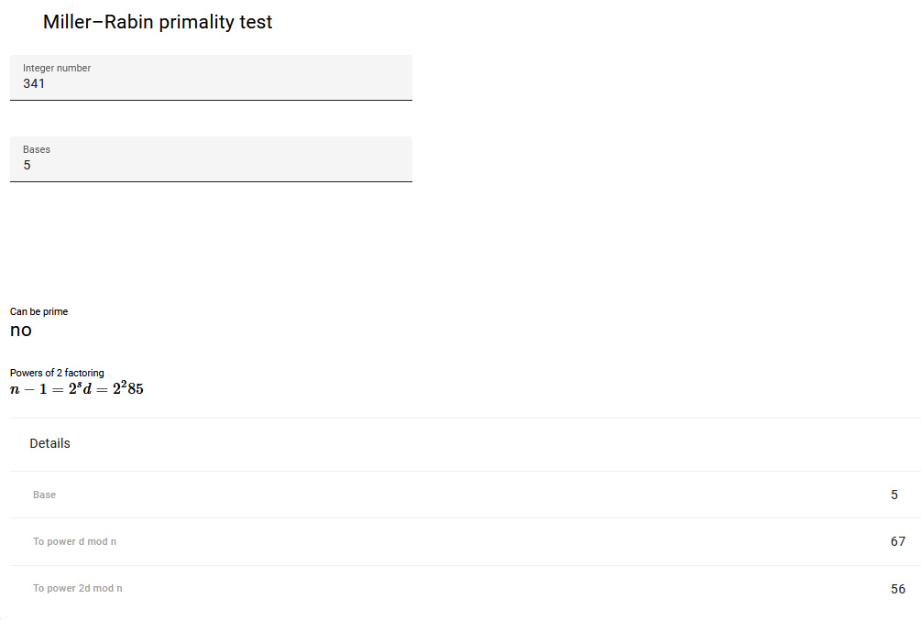
Check if 341 is Prime?
341 is a Composite Number

Slide 83

Check if 341 is Prime?
341 is a Composite Number

Slide 84
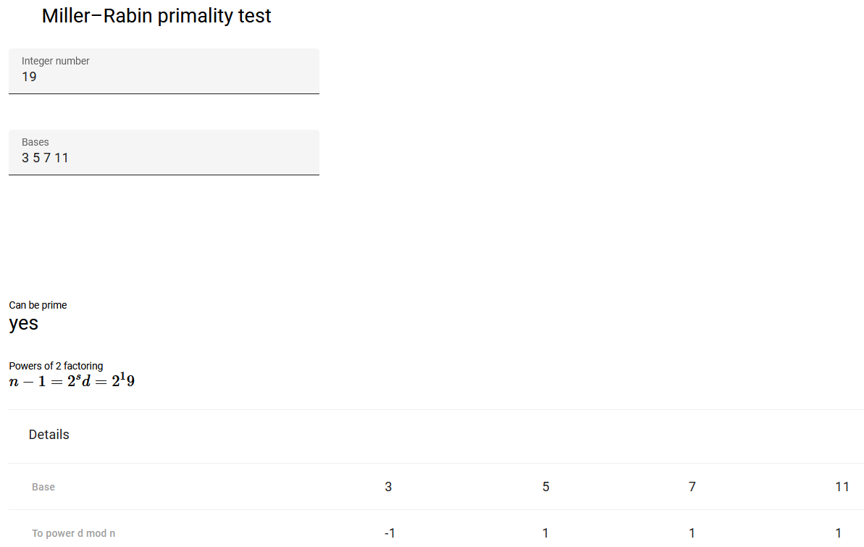
Check if 19 is Prime?

Slide 85
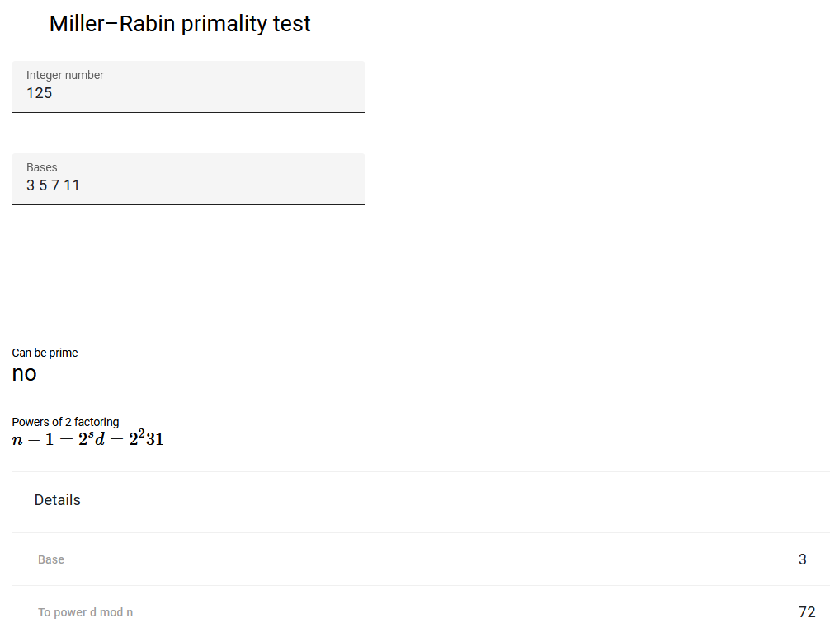
Check if 125 is Prime?

Slide 86
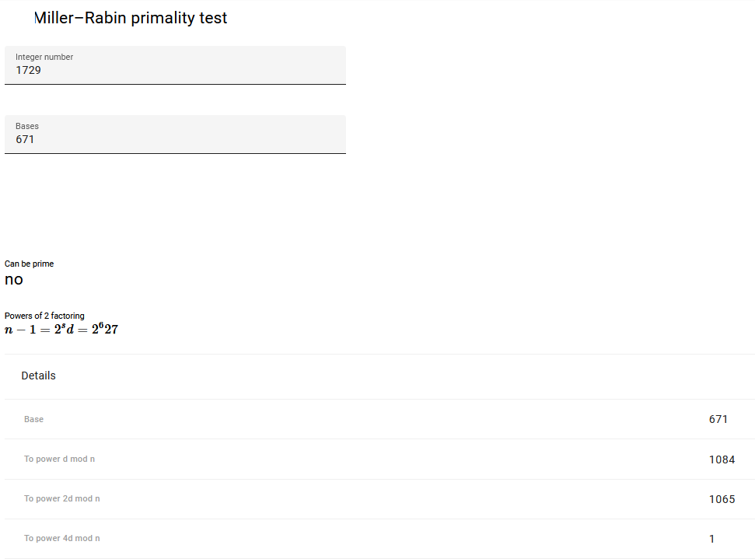
Check if 1729 is Prime?

Slide 87
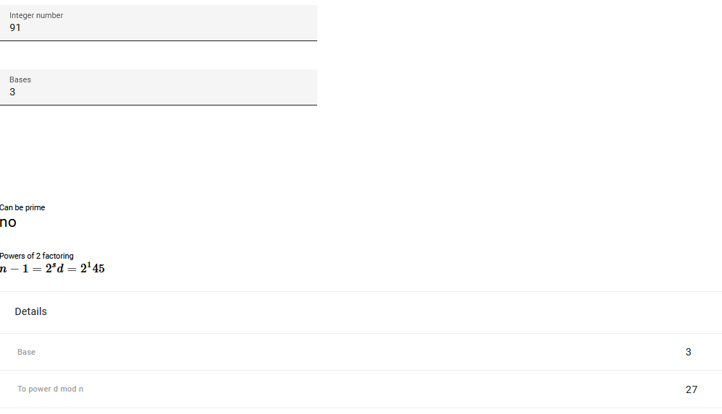
Check if 91 is Prime?

Slide 88
Advantages
This Algorithm can be used to test high numbers for primality.
Because of its advantage in speed when compared to other primality tests, Miller Rabin test will be the test of choice for several cryptographic applications.
When compared to Euler and Solovay-Strassen tests, Miller Rabin is more dynamic and essential aspect is that the probability of failure is decreased.
According to the fermat test there are too many liars for all Carmichael numbers n, the error probability is near to 1, this disadvantage is prevented in Miller Rabin.

Slide 89
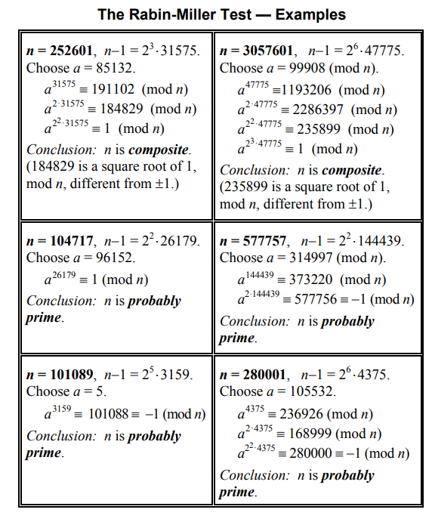
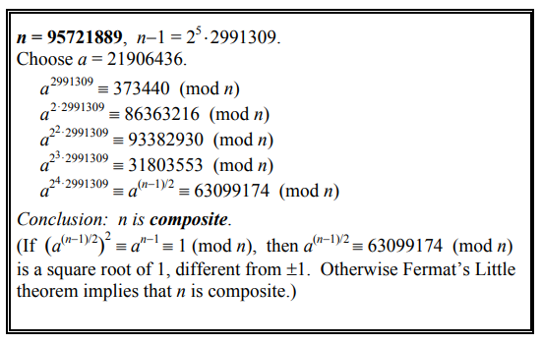

Slide 90
References
https://www.nesoacademy.org/cs/11-subject/02-abstract-algebra-and-number-theory/05-modular-exponentiation-part-1
https://planetcalc.com/8995/

